Slide 1
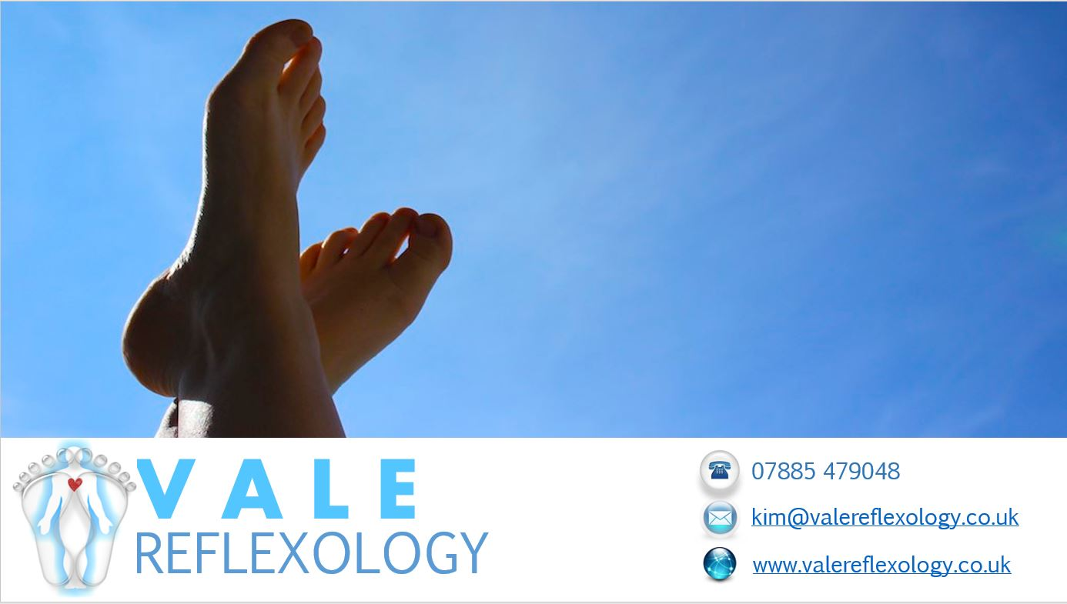
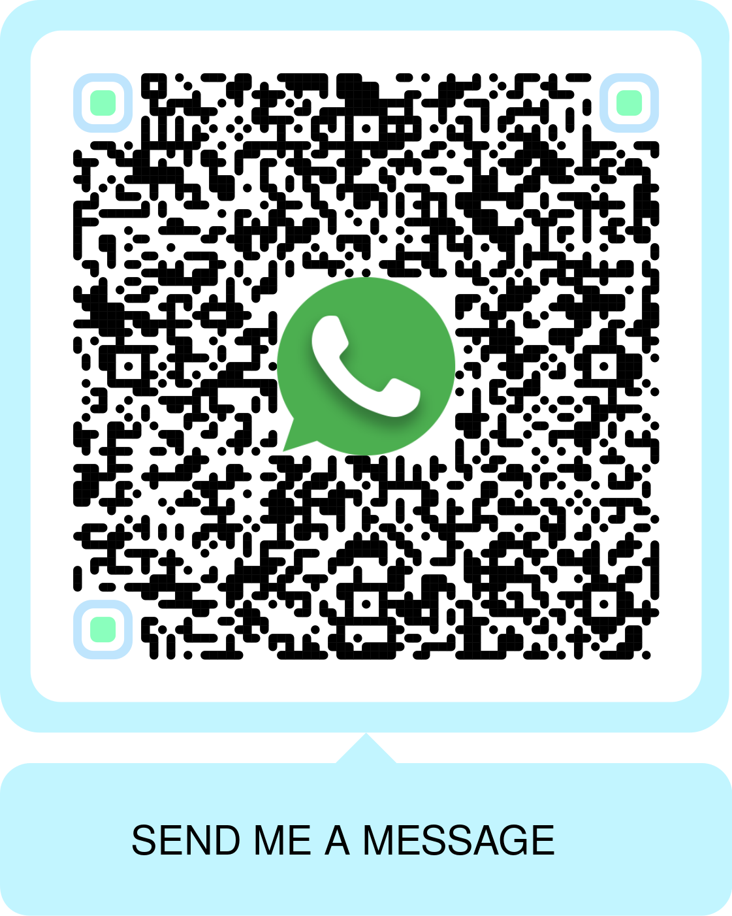
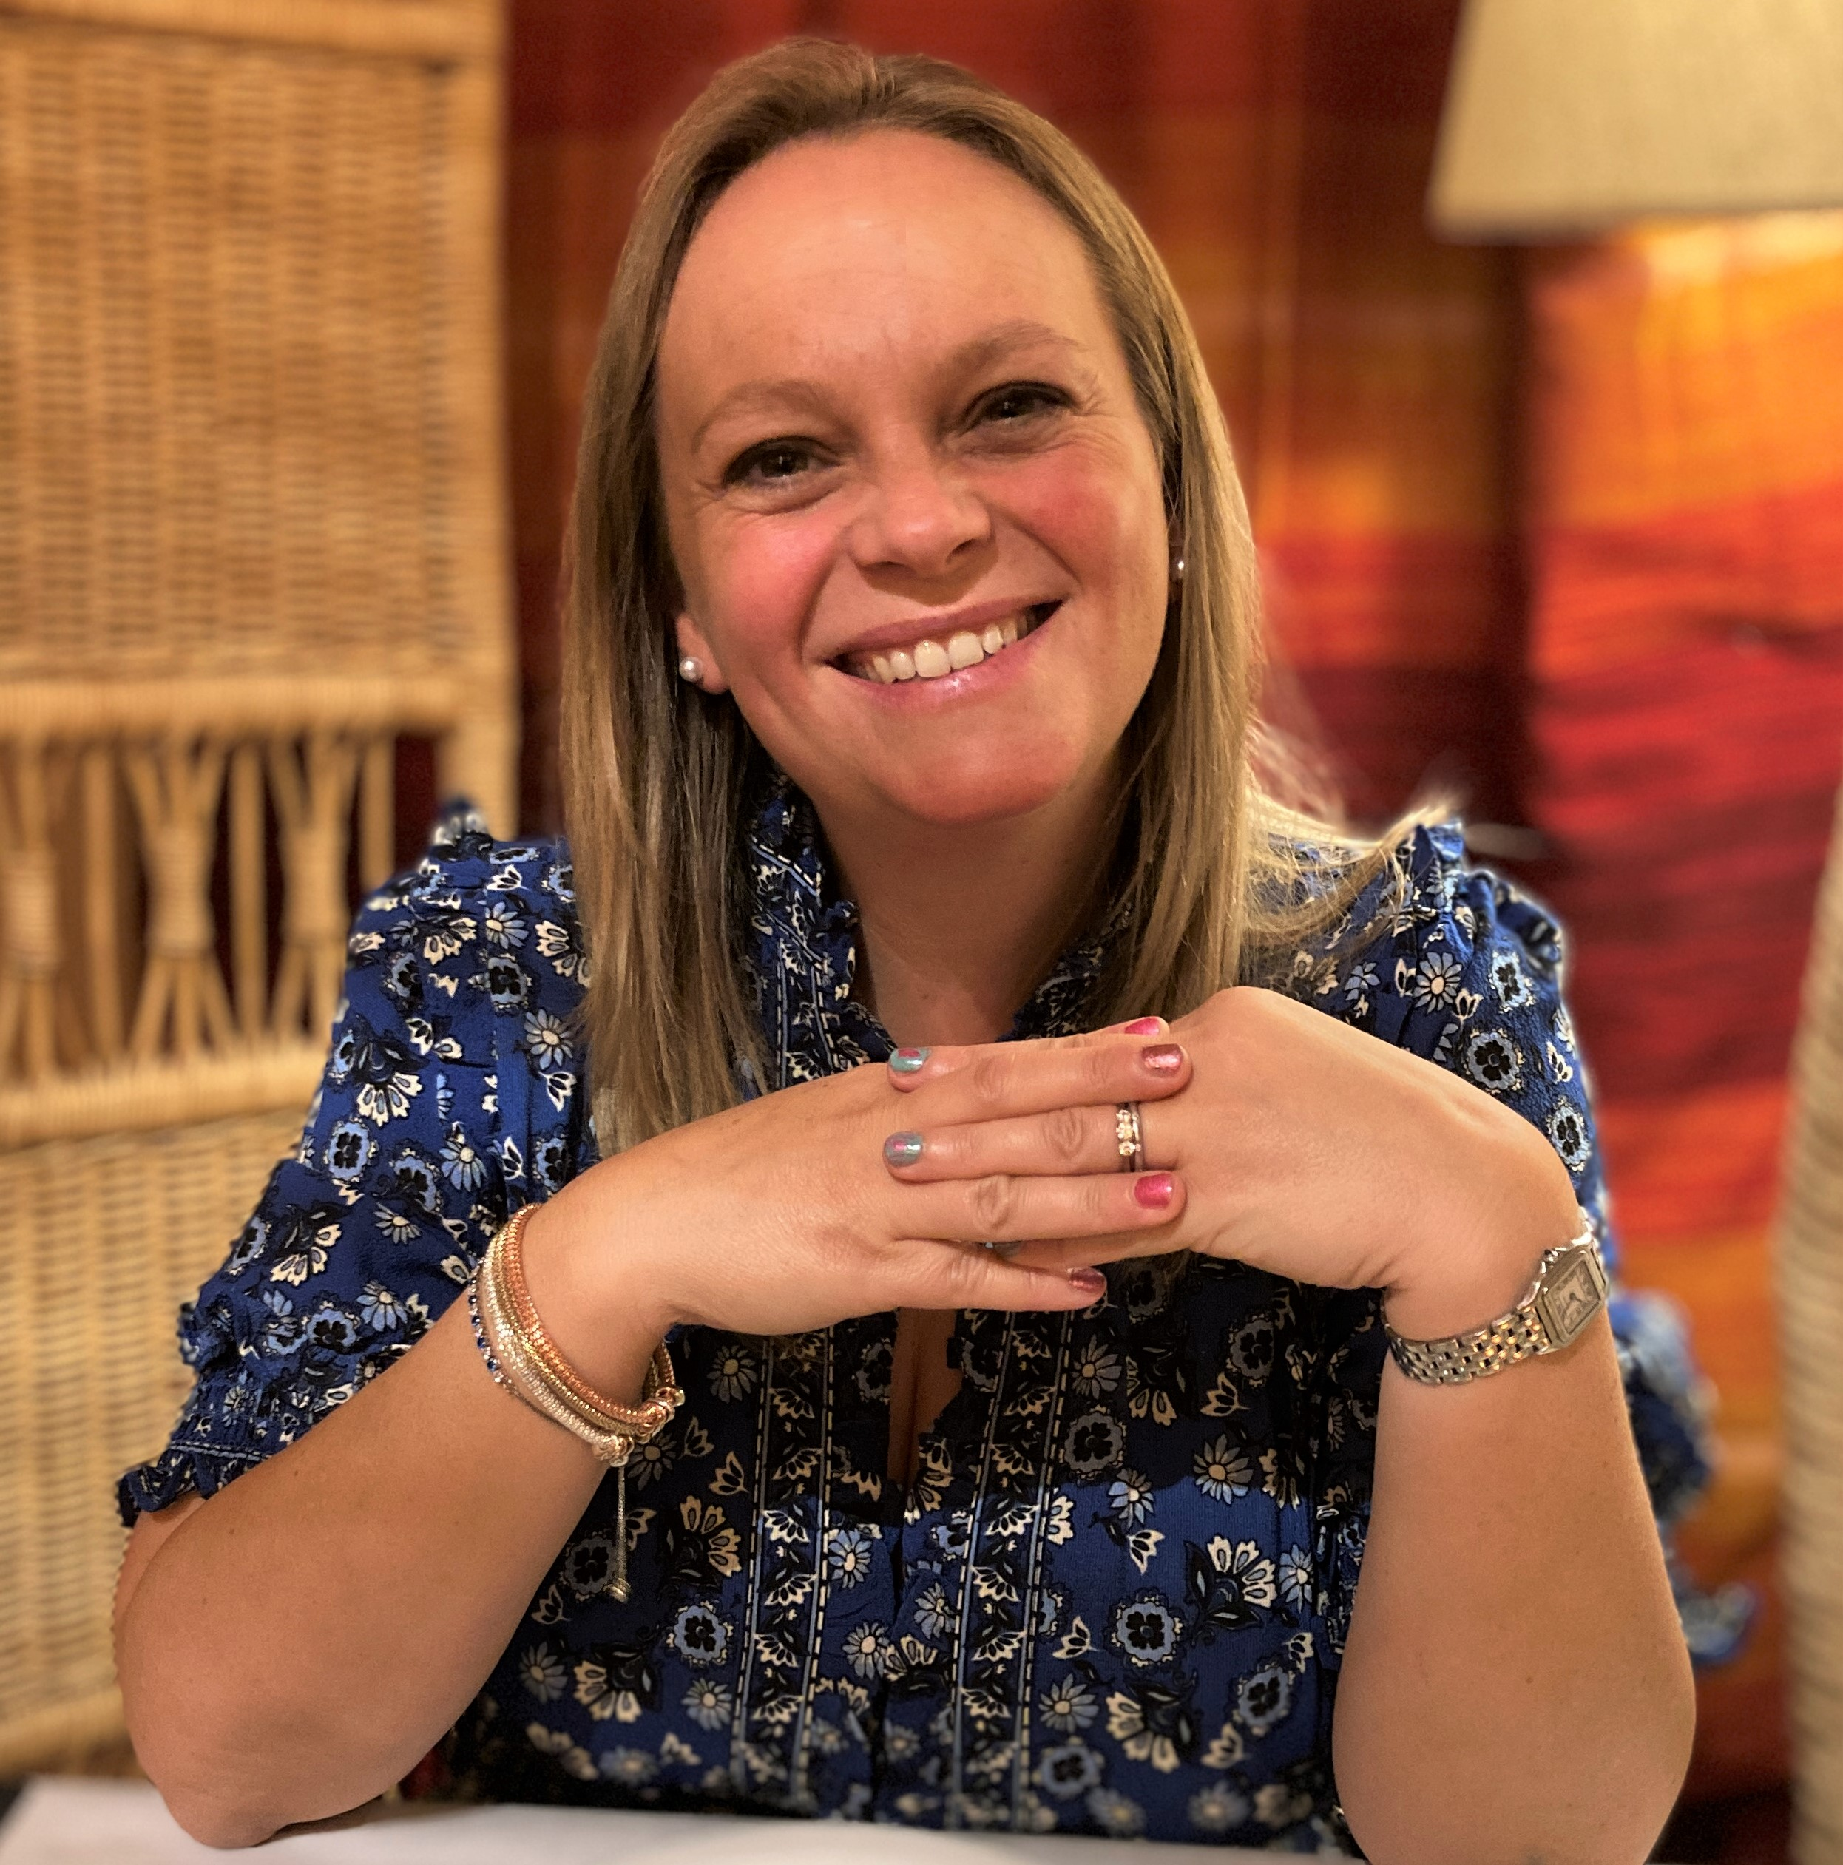
Do you suffer from stress, sleep, heart burn, depression, digestion or similar health issues?
Have you through of trying reflexology? – a holistic therapy that’s been practiced for over 5000 years to support people with these types of health problems by promoting relaxation therapy to restore the mind and body’s natural balance
My name is Kim, and I treat & improve how patients feel with Reflexology in the Vale of Glamorgan.
Level 5 Duopody Reflexology diploma qualified
Degree qualified in human biology
20 years working with medicines
I offer holistic reflexology therapy and support for both Adults and Children in and around Cardiff, Bridgend, and the Vale

Slide 2
